Slide 1
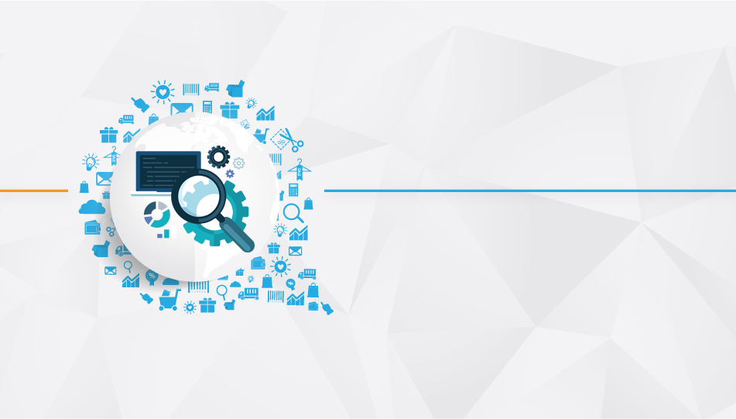

PCF – Pivotal Cloud Foundry

Slide 2
Objective
What is Cloud Foundry?
Interacting with Cloud Foundry via the CLI
Pushing Your First App
explaining Buildpacks
Debugging and montoring logs
Resilience and Availability
Dealing with State
Explaining domain and routes

Slide 3
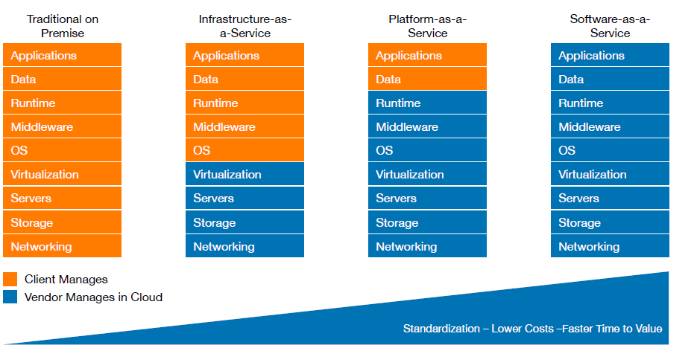
Cloud Delivery Models

Slide 4
What is cloud foundry ?
Initial release in 2011
An open Cloud Native Platform (PaaS)
Fast and easy to build, test, deploy & scale apps
Works with any language or framework
Available as open source, commercial distributions or hosted offerings

Slide 5
What is PaaS?
Platform as a Service
Cloud Computing taxonomy: IaaS, PaaS, and SaaS
PaaS aims to improve developer productivity
Reduces undifferentiated ‘plumbing’ aka ‘yak shaving’
Heroku blazed a trail for PaaS and 12 Factor apps (https://12factor.net/)
Applications are the Cloud Native unit of currency
What characterises Cloud Native?
12 Factor architectural style
Embracing low cost of change in cloud
Fast feedback and small batch sizes
Why a Cloud Native Platform?
Don’t waste time on plumbing infrastructure
Deliver business value more often
Learn about your customers more quickly

Slide 6
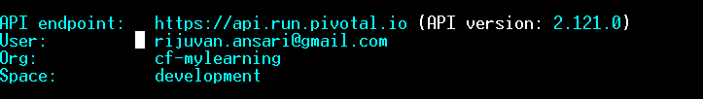
Interacting with Cloud Foundry via the CLI
https://pivotal.io/
Create account ( if don’t have )
Login on at :
https://login.run.pivotal.io/login
--- Down load CLI and start working
https://docs.run.pivotal.io/cf-cli/install-go-cli.html#windows (
Download and start working )
Login to the CF :
Cf login -a https://api.run.pivotal.io
How do I interact with CF?
Command Line Interface (CLI): from terminal / command prompt
IDE plugins
Vendor specific consoles
CI tool integration (e.g Concourse.ci)

Slide 7
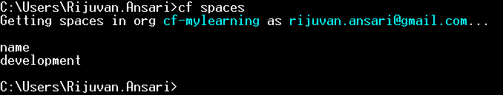
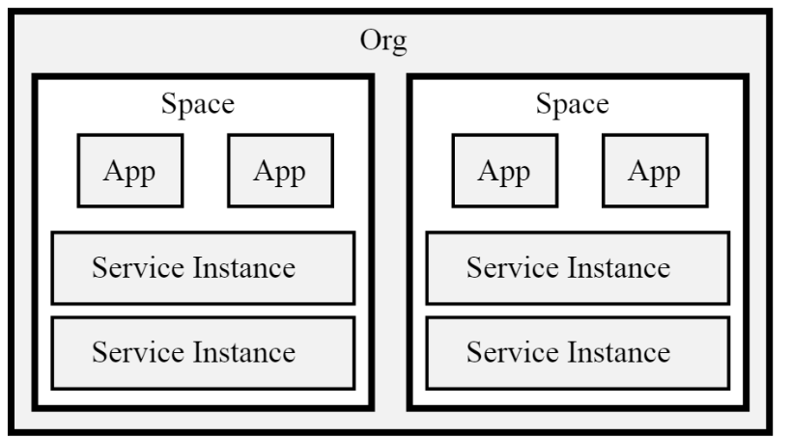

CF Commands
Every application and service is scoped to a space
What is the relationship between orgs, spaces & apps?
Organisations segregate tenants in a Cloud Foundry installation.
Quotas provide resource limits to orgs and spaces
Run cf target to confirm your org and current space.

Slide 8
Pushing Your First App
I want my app to be accessible at a public URL So that the whole world can see it.
What happens when I cf push?
Upload: App files sent to CF
Staging: Executable artifact is created (droplet)
Running: App starts on an app host
App receives web requests (if it binds to TCP port)
Buildpacks create a runnable artifact called a droplet
App Files + Runtime Dependencies = App Artifact (droplet)
Apps are started on specialized VMs called cells
If it’s a web process, it binds to a TCP port
Instances are distributed across multiple cells
Router distributes traffic across instances

Slide 9
Buildpacks
I want the PaaS to manage dependencies:
Buildpack: A Cloud Foundry component that resolves your app’s runtime dependencies
Simplify app deployment -> focus on your code Fewer files, quicker app deploys
Produce self-contained, runnable and cacheable app artifacts.
Types of Buildpacks
Default buildpacks (included in the platform)
Community buildpacks: Leverage the community
Custom buildpacks: Build your own

Slide 10
Resilience and Availability
I want my app to be resilient So that random failures won’t take it offline
$ cf scale training-app -i 3
$ cf apps
What happens when instances fail?
They are automatically recreated by comparing desired state to actual state
I want to know what my CF app is doing
So that I can debug it
cf logs App logs
cf events App events
App instrumentation via 3rd party tools
cf ssh SSH access to the app container

Slide 11
Dealing with State
How do I see all available service offerings?
Domains and Routes:
I want to deploy a new version of my app With no interruptions to my users
Domains: provide a namespace from which to create routes
Shared domain: for all of CF
Private domain: scoped to an Org
Requires DNS to be configured
Route: A URL on which an application can be accessed.
Many to Many Relationship between apps & routes.
Blue/Green Deployments:
Deploy a new version (GREEN) of your app.
Map the route to it
Validate
Unmap from the old version (BLUE)

Slide 12
Thank You

Slide 13

www.infogain.com
Infogain Corporation, HQ
485 Alberto Way Los Gatos, CA 95032 USA
Phone: 408-355-6000
Fax: 408-355-7000
Pune
7th Floor, Bhalerao Towers, CTS No.1669 - 1670, Behind Hotel Pride,
Shivaji Nagar, Pune - 411005
Phone : +91-20-66236700
Infogain Irvine
41 Corporate Park, Suite 390 Irvine, CA 2606 USA
Phone: 949-223-5100
Fax: 949-223-5110
Infogain Austin
Stratum Executive Center Building D 11044 Research Boulevard Suite 200
Austin, Texas 78759
Noida
A-16, Sector 60, Noida Gautam Budh agar, 201301 (U.P.) India
Phone: +91-120-2445144
Fax: +91-120-2580406
Dubai
P O Box 500588 Office No.105, Building No. 4, Dubai Outsource Zone,
Dubai, United Arab Emirates
Tel: +971-4-458-7336

